Slide 1
Used Car Inventory System
By
Abhishek Bhatt
Balasubramanian Thiagarajan

Slide 2
IDEA
The project deals with building a used car inventory system.
The system allows the users to browse through a list of used cars based on various car attributes and select the car of their choice for purchase.
It aids them in buying a used car based on their preferences.

Slide 3
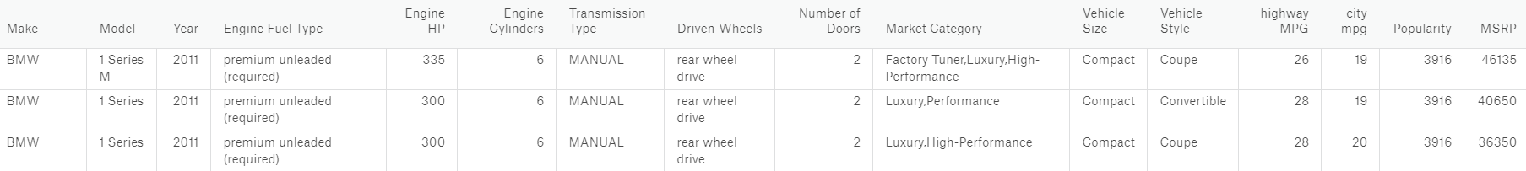
DATASET
The dataset being used to build the system is obtained from a dataset in Kaggle.
It contains over 10,000 cars with various car attributes like Make, Model, Price, Year, and Mileage.
The dataset is stored in Firebase Realtime Database.

Slide 4
APPLICATION
We have created a web application for implementing the system.
Key Components of the Application:
User Login / Sign Up Interface
Search Interface & Engine
Cloud Database
Languages used – HTML, CSS, JavaScript, Python

Slide 5
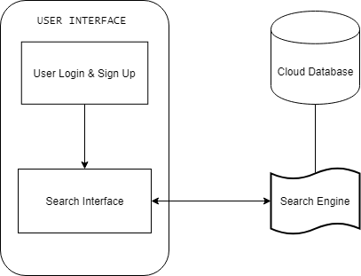
ARCHITECTURE

Slide 6
APPLICATION
The users create a personalized user account by signing up and logging in.
The search engine takes keywords from the user and queries the database. The output of the query is obtained from the database and displayed to the user. The users can save their previous searches and view their saved search history.
The users also have the option of performing a specific search using few important car attributes and an advanced search using the facets present.
The following facets are present for faceted search:
Vehicle Size
Year
Number of Doors

Slide 7
CHALLENGES ENCOUNTERED
The following challenges were encountered in implementing the system:
Formulating the dataset to be used in the system.
Implementing the web application.
Formulating the search facets and implementing them.

Slide 8
DEMO

Slide 9
THANK YOU

